Slide 1
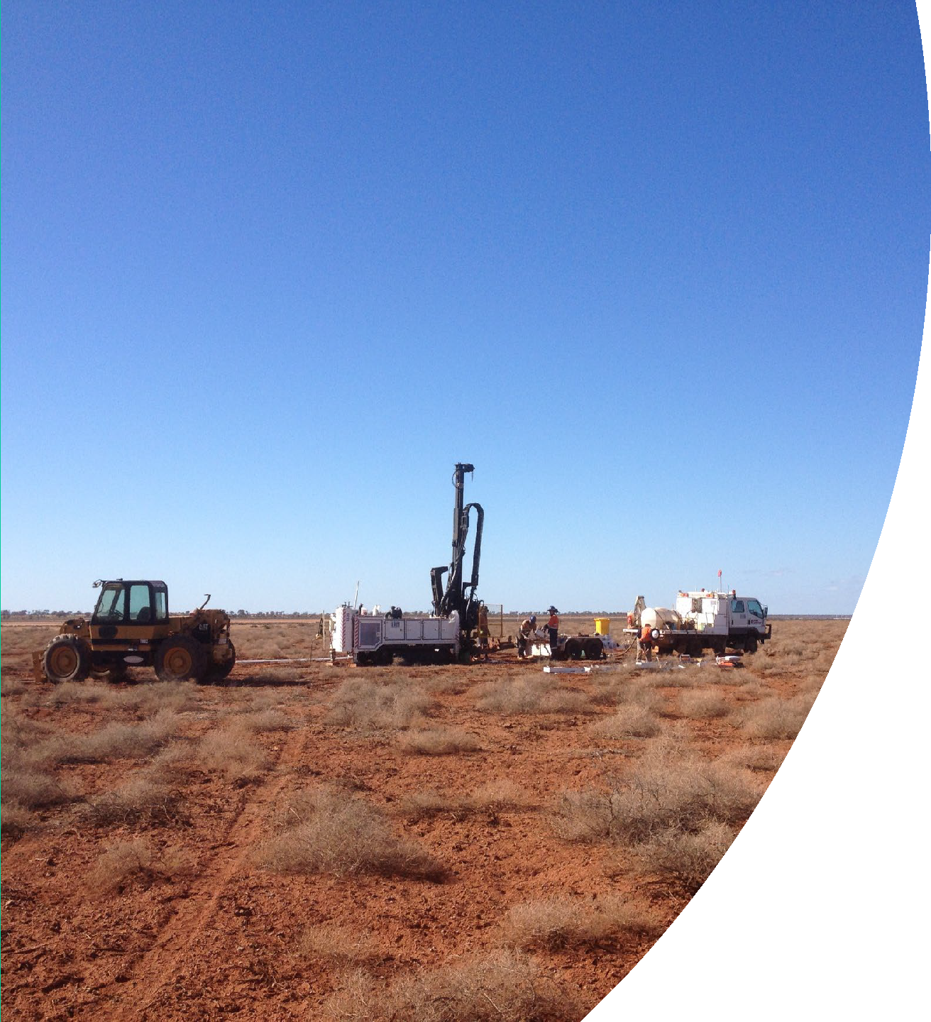
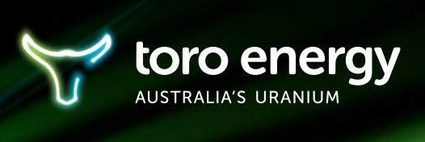
Toro Energy Ltd
ASX:TOE
Investor Presentation
Transformational Upgrade of the Wiluna Uranium Project
24 November 2022
Powering a Clean Energy Future

Slide 2
DISCLAIMER
This presentation has been prepared by Toro Energy Limited (“Toro”). The information contained in this presentation is a professional opinion only and is given in good faith. Certain information in this document has been derived from third parties and though Toro has no reason to believe that it is not accurate, reliable or complete, it has not been independently audited or verified by Toro.
This presentation is not to be construed as legal, financial or tax advice and any recipients of this information (“Recipients”) or prospective investors should contact their own legal adviser, independent financial adviser or tax adviser for legal, financial or tax advice.
Any forward-looking statements included in this document involve subjective judgement and analysis and are subject to uncertainties, risks and contingencies, many of which are outside the control of, and maybe unknown to, Toro. In particular, they speak only as of the date of this document, they assume the success of Toro’s strategies, and they are subject to significant regulatory, business, competitive and economic uncertainties and risks. No assurance can be given by Toro that the assumptions reflected in any forward looking statements will prove to be correct and actual future events may vary materially from the forward looking statements and the assumptions on which the forward looking statements are based. Recipients are cautioned to not place undue reliance on such forward-looking statements.
Toro and its officers, employees, related bodies corporate and agents (“Agents”) make no representation or warranty, express or implied, as to the accuracy, reliability or completeness of information or opinions in this document and do not take responsibility for updating any information, providing recipients with access to additional information or correcting any error or omission which may become apparent after this document has been issued.
To the extent permitted by law, Toro and its Agents disclaim all liability, direct, indirect or consequential (and whether or not arising out of the negligence, default or lack of care of Toro and/or any of its Agents) for any loss or damage suffered by a Recipient or other persons arising out of, or in connection with, any use or reliance on this presentation or information. All amounts are in A$ unless stated otherwise.

Slide 3
CORPORATE SNAPSHOT
Capital Structure
ASX Code | TOE
Shares on issue | 3,897,342,180
ASX Share price¹ | $0.016
Options on issue | 446m
Cash and Securities (31 October 2022) | $3.5m
Market Cap¹ | $62m
Substantial Shareholders
Board of Directors
Richard Homsany | Executive Chairman
Michel Marier | Non–Executive Director
Richard Patricio | Non–Executive Director
Sentient Group Ltd (19.91%) Other (67.33%)
Mega Uranium Ltd (12.76%)
1.
As at 23 November 2022

Slide 4
INVESTMENT HIGHLIGHTS
100% owned Wiluna Uranium Project offers significant uranium exposure of 52Mlt @ 548ppm for 62.7M pounds U₃O₈ which forms part of total JORC 2012 Mineral Resources of 90.9M pounds U₃O₈ (200ppm cut-off) across its various projects.
Vanadium may be a viable by-product as can be processed at a low marginal cost. Toro has a significant maiden total Inferred JORC 2012 Resource of 68.3M pounds of V₂O₅ (200ppm cut-off) inside the uranium resource envelopes for each uranium deposit.
Federal and State environmental approvals received. Retrospective amendment to substantial commencement date condition will be required. Amendment to mining proposal required resulting from further studies which significantly enhanced the Project. All mining leases granted.
Significant
Uranium & Vanadium Inventory
Government
Approvals
Scoping Study for the Lake Maitland Uranium Deposit disclosed a strong A$610M NPV pre tax, and modest capital and operating costs. CAPEX of AUS$270M (US$189.5M) (US$:AUS$ 0.70), inclusive of a 20% contingency and 15% EPCM allowance. 2.5 year payback.
Life of Mine C1 operating cost US$23.10/lb U₃O₈ and AISC US$28.02/lb U₃O₈
Pit re-optimisation at Lake Maitland resulted in a transformational potential increase in production resulting from processing improvements and cost reductions.
Wiluna Uranium Project studies continue
Drill program at Dusty Nickel Project continues
Four (4) Discoveries of Massive/Semi-Massive Nickel Sulphides to date at Toro’s 100% owned Dusty Nickel Project located in the Yandal Greenstone Belt approx. 50km east of world-class Mt Keith Nickel deposit. Over 15km testing for extension strike length of komatiite - ultramafic target rock for Massive Ni Sulphides.
Diamond drilling continues.
Richard Homsany (Executive Chairman), an officer of Mega Uranium (TSE:MGA), director of various ASX & TSXV companies. Richard Patricio (NED), is currently CEO of Mega Uranium (TSE:MGA) and a Director of NextGen (TSE:NXE). Michel Marier (NED) is an Investment Manager at Sentient Group. Dr Greg Shirtliff leads the technical team with 20 years uranium experience in exploration & mining including prior roles with Cameco & ERA.
Experienced Board & Management

Slide 5
MACRO OVERVIEW OF URANIUM SECTOR
URANIUM MARKET
Key driver is the demand from nuclear energy utilities. Affected by demand for, and share of, electricity generated by nuclear.
Contract pricing is mostly on a long term supply basis (3-5 years) priced at a premium to spot pricing.
Prices have been buoyed as a result of:
- mine production cuts from excess supply and depressed demand.
- further production cuts in 2020 due to COVID.
- Sprott Physical Uranium Trust purchased 41.3Mlbs U₃O₈ over 2021 and 17.9Mlbs U₃O₈ in 2022. Intends to hold its inventory indefinitely and considers the shift towards green energy will accelerate uranium demand, especially given the recent rise in natural gas & coal prices.
- competing funds such as UK-based Yellow Cake Plc (inventory of 18.8Mlbs U₃O₈ at Aug 2022) and the Kazakhstan-based ANU Energy OEIC Limited have also been buying physical uranium from industry participants.

Slide 6
MACRO OVERVIEW OF URANIUM SECTOR
Energy diversification (e.g. away from coal & Russian fuels) and energy security are critical issues.
Russia-Ukraine conflict has impacted the uranium market. Nuclear utilities & fuel suppliers expressing concerns with less affinity to transact with Russia.
The increasing but intermittent renewable energy supply increases the need for reliable back-up power generation. As available grid storage options are currently limited by costs and other factors, natural gas generators remain the key back-up power source.
Recent supply-chain & geopolitical events affecting fossil fuel markets has resulted in
record high natural gas prices making nuclear power a relatively cheaper option.
High costs of energy infrastructure construction facilitates life extensions to existing nuclear reactors.
De-carbonisation The uranium market is forecast to be driven by increases in demand for cleaner base load electricity production. As concerns about greenhouse gas emissions from fossil fuels continue rising, uranium is seen as an attractive alternative for reliable base load power supply as it produces no greenhouse gas emissions and consumes relatively little fuel in comparison to fossil fuel plants. Once a nuclear reactor is up and running, fuel cost (uranium rods) in the OECD is typically approx. 1/3rd of a coal-fired plant and between 1/4th or 1/5th of those for a gas combined cycle plant.

Slide 7
MACRO OVERVIEW OF URANIUM SECTOR
CONSUMPTION
Nuclear power development being adopted by a broader array of countries with several building nuclear power for the first time or pivoting back to it.
France: six (6) new nuclear reactors are to be constructed & a further eight (8) are under consideration.
China: continues to progress with numerous reactors.
Multiple nuclear reactor re-starts in Japan (3rd largest economy) announced by PM in Aug 2022 & desire to build next gen reactors.
Construction of Small Modular Nuclear Reactors to complement carbon free renewable energy an increasing source of uranium demand.
April 2022: US Department of Energy announced US$6 billion Civil Nuclear Credit Program to support continued operation of US nuclear reactors and avoid “premature retirements…and protect our supply of carbon free electricity generation”.
PRODUCTION
Large suppliers shifting back towards full production eg Cameco’s McArthur River.
Supply shortfalls may emerge as existing mines gradually deplete over the medium term. Uranium mines typically require an extensive approvals process, potentially exacerbating supply shortages in long term and creating a baseline for structurally higher prices.

Slide 8
FUTURE DEMAND FOR URANIUM
IS ESCALATING
Global nuclear reactor fleet will continue to grow
 | Operable reactors⁽¹⁾ | Reactors Under Construction⁽¹⁾ | Planned reactors⁽¹⁾ | Proposed reactors⁽¹⁾
Global Reactor Fleet | 437 | 59 | 100 | 334
Source:
1) World Nuclear Association, World Nuclear Power Reactors & Uranium Requirements (October 2022)

Slide 9
GLOBAL SUPPLY OF URANIUM
IS CONCENTRATED
U₃O₈ Production is Concentrated
The Top 5 Companies Produce 59% of the Total
Supply in 2021⁽¹⁾
Global production by mine
(mlb U₃O₈, 2021)
Production by Country ⁽¹⁾
(%, 2021)
50.0%
Kazatomprom
44.7%
Cigar Lake 12.2
Husab 9.1
Olympic Dam 9.0
Katco 7.8
Inkai 7.1
Top 5 Total 45.2
Other 81.6
World 126.8
45.0%
31.4
Orano
11.8
40.0%
35.0%
Uranium One
11.6
30.0%
CGNPC
11.0
25.0%
Cameco |  |  | 9.7
Top 5 Total |  |  | 75.5
Other |  |  |  | 52.1
World |  |  |  | 127.7
20.0%
17.9%
15.0%
11.5%
10.0%
9.6%
9.1%
7.2%
5.0%
0.0%
Kazakhstan
Namibia
Canada
Australia Uzbekistan All Other
Source:
1) MineSpans Q2 2022

Slide 10
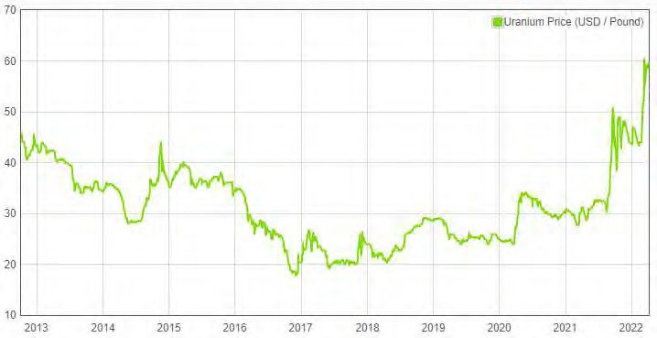
URANIUM PRICES RISING -
URANIUM SENTIMENT GAINING PACE
URANIUM PRICES
According to the Australian Government’s Office of Chief Economist Resources and Energy Quarterly (March 2022 Edition), a long period of low prices has resulted in many uranium projects being deferred or cancelled, leading to expected uranium shortfalls in the near to medium term.
Greater investor interest in the uranium spot market.
Uranium prices (US$/lb) over the past 10 years
(Source: Dailymetalprice.com (accessed 5 April 2022)

Slide 11
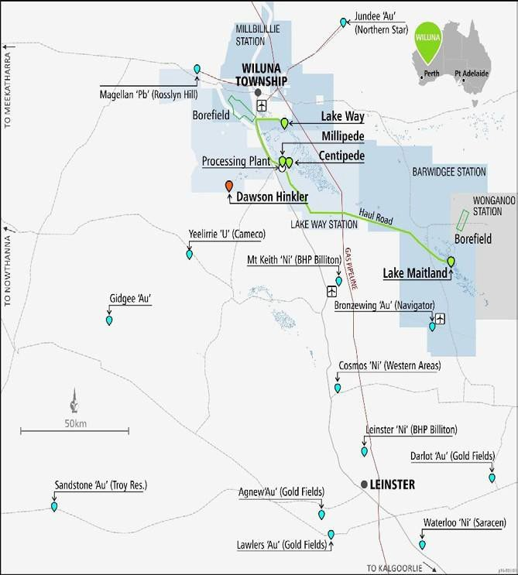
WILUNA URANIUM PROJECT
Key risk areas addressed…Leaving focus on process design and project costs.
96% of 62.7Mlb permitted resources is Measured & Indicated supporting long life operations (at 200ppm U₃O₈ cut-off).
State and Federal government environmental approvals obtained (require amendment)
All granted.
Resources
Approvals
Mining leases
Simple mining -mineralisation from surface to 15m – Ave.1:17 strip ratio.
Lake Maitland has reputable Japanese JV partners: JAURD/Itochu.
Established mining centre - access to water, power and services.
Mining
Infrastructure
Vanadium- potential valuable by- product with low marginal production cost.
Maiden V₂O₅ JORC 2012 Resource of 68.3Mlbs.
Vanadium Potential
8

Slide 12
Scoping Study for a stand-alone Lake Maitland Uranium-Vanadium Operation completed in late October 2022 (SRK Consulting Australasia & Strategic Metallurgy)
Highlights of that study include:
LAKE MAITLAND DEPOSIT SCOPING STUDY – STRONG RESULTS
Excellent financial outcomes
  NPV pre-tax of approximately A$610M at a discount rate of 8%
  IRR of 41%
  Rapid payback period of 2.5 years
  Total EBITDA of $1,768.6M
  Total undiscounted cash flow of A$1,423M pre-tax
  Average EBITDA of A$101M per annum
  Average undiscounted cash flow of $81.3M per annum
  Estimates assume a US$70/lb U₃O₈, US$5.67/lb V₂O₅ price and a US$:A$0.70 exchange rate
  Modest CAPEX
  US$189M (or A$270M) capital cost estimate including contingency (20%) and EPCM (15%).
  Includes all infrastructure for the proposed stand-alone Lake Maitland operation, including:
    entire processing facility with beneficiation plant and ability to produce both a uranium and vanadium product; and
    all mining & administration related infrastructure, access roads, power plant, borefield and a reverse osmosis desalinisation plant for water supply
  A$133M processing infrastructure build cost (A$95.8M excluding contingency and EPCM)
  A$137M non-processing infrastructure build cost (A$99.2M excluding contingency and EPCM)

Slide 13
LAKE MAITLAND DEPOSIT SCOPING STUDY – STRONG RESULTS
Highlights (continued)
Low operating cost estimates
C1 Cash operating cost of US$15.84/lb U₃O₈ over the first 7 years
C1 Cash operating cost of US$23.10/lb U₃O₈ over Life of Mine (LoM)
All In Sustaining Cost (AISC) of US$20.32/lb U₃O₈ over the first 7 years
AISC of US$28.02/lb U₃O₈ over LoM
Robust estimate operating margins
C1 (US$15.84) and AISC (US$20.32) for the first 7 years provides Toro with very strong margins during the initial payback period
Mining and Production
Mine life of approximately 17.5 years
Low average strip ratio of 1.17
Process approximately 1.94Mt of ore per annum (front of beneficiation plant)
Annual average production approximately 1.3Mlbs U₃O₈ (100% Indicated Resource) and 0.7Mlbs V₂O₅ (100% Inferred Resource)
Total production approximately 22.8Mlbs of U₃O₈ and 11.9Mlbs of V₂O₅
See release of 24 October 2022 for further information
ASX Listing Rule 5.19.2
The Company confirms that all material assumptions underpinning the production target and the derived forecast financial information disclosed in the Scoping Study announced by the Company on 24 October 2022 continue to apply and have not materially changed.

Slide 14
LAKE MAITLAND SCOPING STUDY
Vanadium (as V₂O₅) successfully integrated into the Lake Maitland uranium
(as U₃O₈) resource.
Re-optimisation of the proposed Lake Maitland open cut uranium mine has been completed and takes into account:
  the added net value of the V₂O₅ production;
  all of the cost efficiencies resulting from R&D activities; and
  the downstream changes & improvements in the processing stream.
Re-optimisation successfully lowered the optimised mining cut-offs and results in more of the resource being processed over the life of the mine - significant increase in the Wiluna Uranium Project’s value.
The successful scoping level research and improvements achieved at Lake Maitland to date also highlight opportunities within the broader Wiluna Uranium Project resulting from the potential improved economics at Lake Maitland.

Slide 15
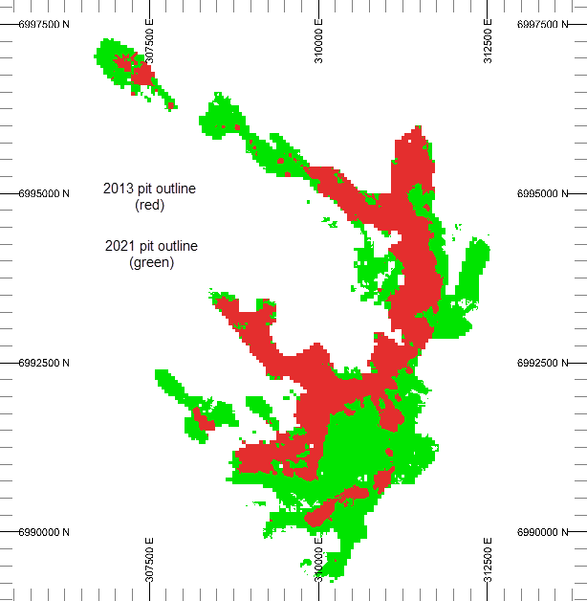
RESULTS OF 2022 LAKE MAITLAND PIT RE-OPTIMISATION
Huge expansion of the pit & increase in potential uranium ore is
transformational for the value of Toro’s Wiluna assets
New pit shell (revised pit rim cut-off grade of 109ppm U₃O₈) stretching beyond bounds of current stated resource at a 200ppm U₃O₈ cut-off. A significant lowering of the U₃O₈ grade for the potential Lake Maitland ore (631ppm to 380ppm U₃O₈);
Potential ore increasing from 13.2Mt to 35.2Mt (up 167%);
Life of Mine increasing from 10.1 to 17.5 years (up 74%);
Potential U₃O₈ production increasing from 15.8Mlbs to 22.8Mlbs at assumed price of US$70/lb U₃O₈);
11.9Mlbs of V₂O₅ by-product produced (at assumed price of US$5.67/lb V₂O₅); and
Additional US$560,000,000 in potential gross product value is created.
2013 pit outline (RED)
2022 pit outline (GREEN)

Slide 16
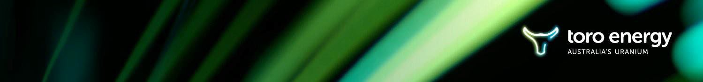
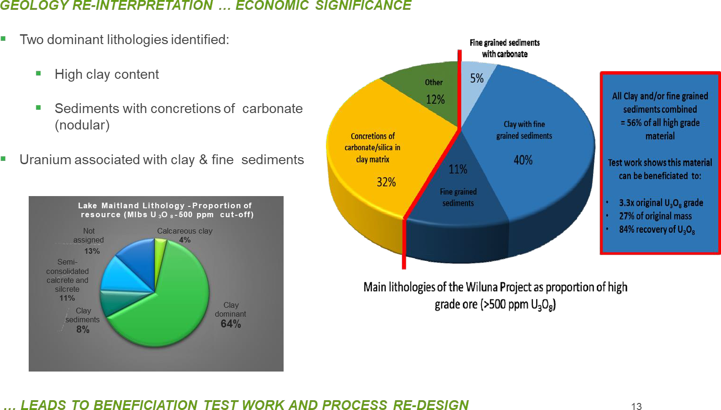
SIGNIFICANT PROCESS IMPROVEMENTS

Slide 17
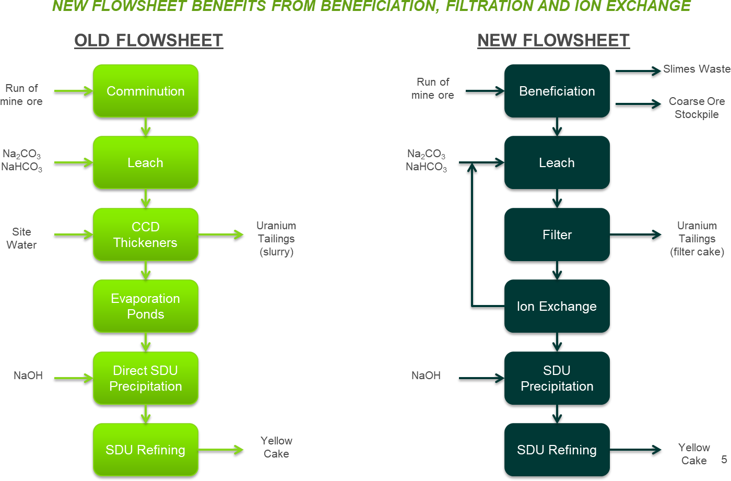
IMPROVED PROCESSING FLOWSHEET

Slide 18
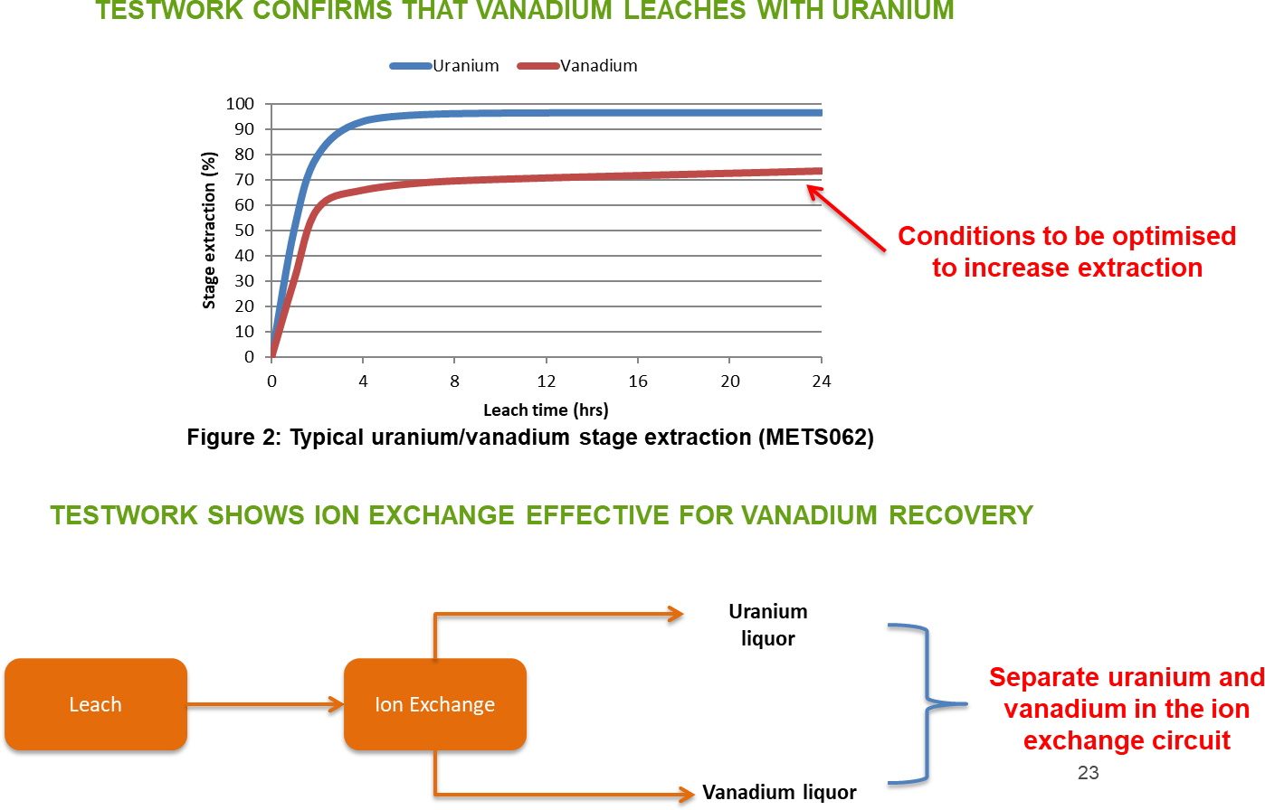
VANADIUM A POTENTIAL VIABLE BY-PRODUCT
KEY ADVANTAGES – INCREASING VALUE OF URANIUM RESOURCE and A DECREASED U₃O₈ INCENTIVE PRICE NEEDED FOR COMMENCEMENT OF PROJECT

Slide 19
SUMMARY OF PROCESS IMPROVEMENTS
Significant and continuous improvements to the overall process as a resultof:
NET RESULT: Lower OpEx and CapEx
Less uranium tailings No grinding
Beneficiation
Produces high grade concentrate
Low grade coarse ore available for future processing
De-slime works on all samples, allows for filtration
Smaller processing
plant
Filtration
No CCD circuit
No evaporation ponds
Easier residue storage
Efficient removal of salts by washing
Drier leach feed cake
Leaching
High uranium extraction in 8hrs
High density in leach (58% solids)
Vanadium leaching
Smaller leach circuit Lower power consumptions
Ion Exchange
Proven efficient on actual liquors
Allows for substantial concentration of uranium
Potential to separate vanadium and uranium
Less sodium hydroxide consumed Smaller SDU circuit

Slide 20
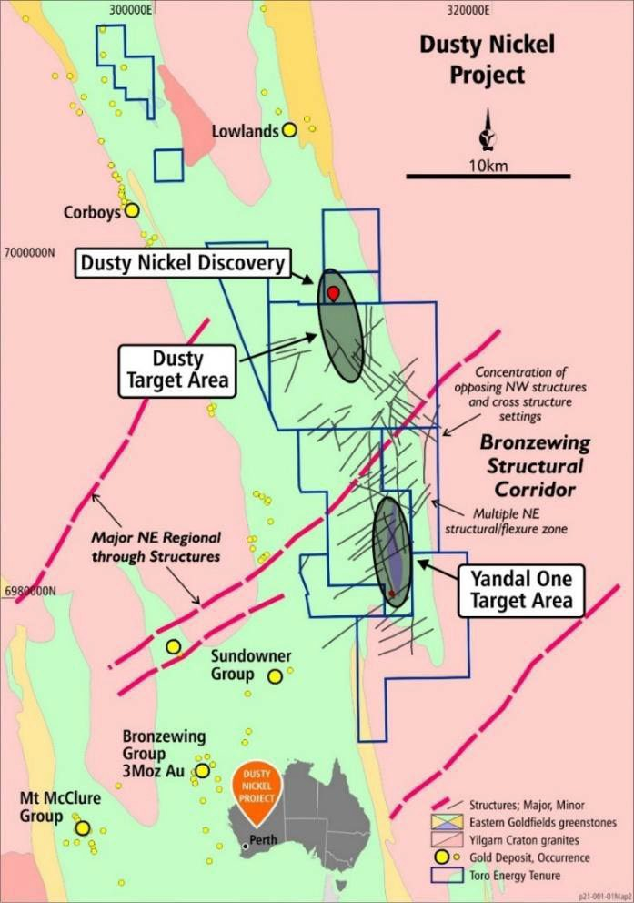
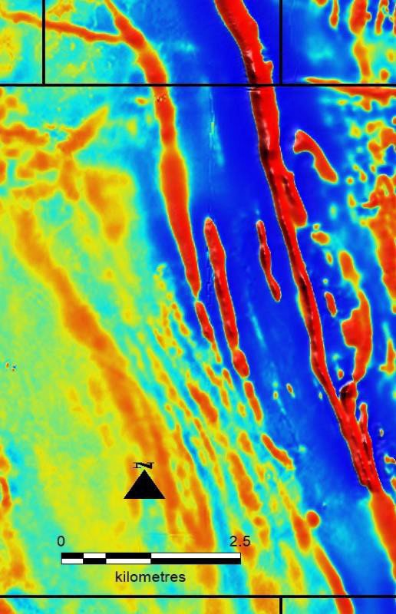

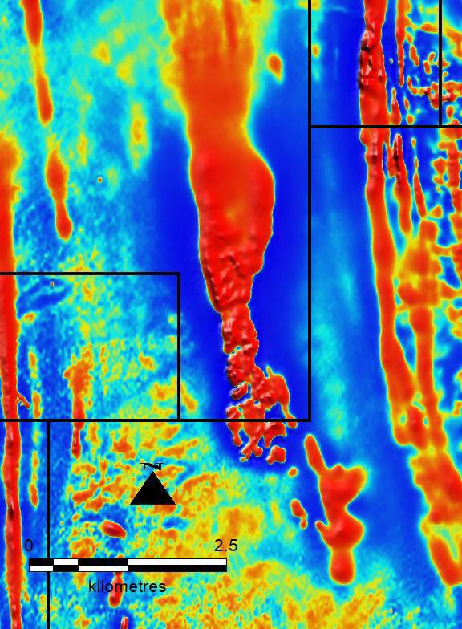
DUSTY NICKEL PROJECT
The Dusty Nickel Project is located on the northern, eastern and southern shores of Lake Maitland and the Lake Maitland Uranium Deposit, and focused on two (2) main target areas, Dusty and Yandal One. It has now been confirmed by drilling that Dusty and Yandal One incorporate over 15km strike length of komatiite-ultramafic target rock for massive nickel sulphides.
DUSTY 1
DUSTY 2
Magnetic Komatiite of the DUSTY
TARGET AREA
Magnetic Komatiite of the YANDAL ONE TARGET AREA

Slide 21
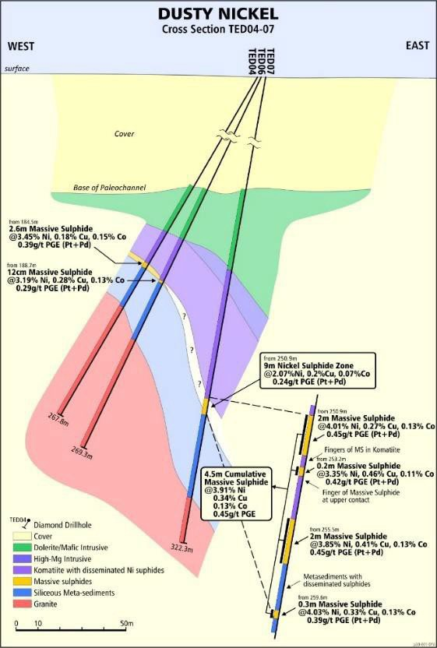
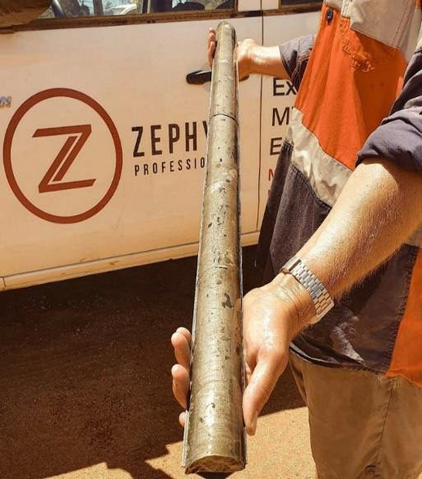
DUSTY NICKEL DISCOVERIES
Blind discovery of massive & semi-massive nickel sulphides at base of a 7.5km unbroken length of previously unknown komatiite (Dusty komatiite) – arguably the 1st massive nickel sulphides discovered in Yandal Greenstone Belt, 50kmE of world class Mt Keith nickel deposit 15km NE of Bronzewing Gold Mine.
Discovered with the first hole drilled through the komatiite testing a geochemical target from aircore drilling. remains largely untested. Despite being in very early stages of exploration there are already 4
different discovery locations, Dusty, Houli Dooley, Jumping Jack & Dimma.
The Dusty komatiite
1. DUSTY - massive and/or semi massive nickel sulphides with up to 9.0m at 2.07% Ni from 250.9m including 2.0m at 4.01% Ni, 0.27% Cu, 0.13% Co and 0.388 g/t Pt + Pd from 250.9m; and 2.0m at 3.85% Ni, 0.41% Cu, 0.13% Co and 0.45 g/t Pt+Pd from 255.5m.
2.6m @ 3.45% Ni, 0.18% Cu, 0.15% Co
and 0.388g/t Pt+Pd from184.5m downhole.
Dusty
2. HOULI DOOLEY – only one hole drilled in location so far, which intersected up to 3.05m of semi-massive nickel sulphide grading 1.59% Ni, 0.06% Co, 0.07% Cu and 0.34g/t Pt+Pd from 297.75m downhole, including 0.75m at 4.3% Ni, 0.15% Co, 0.1% Cu, 0.89g/t Pt+Pd from 297.75m downhole.

Slide 22
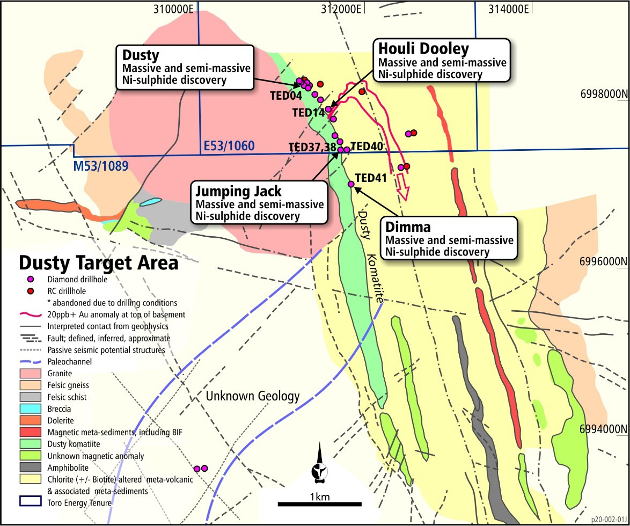
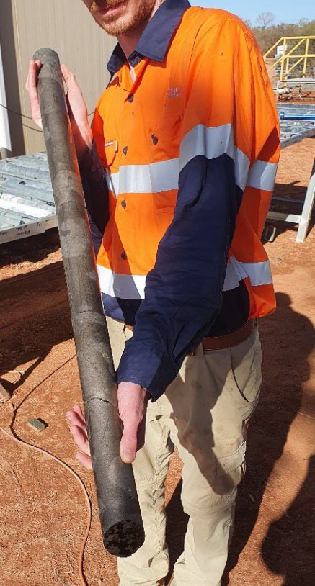
DUSTY NICKEL DISCOVERIES
3. JUMPING JACK
Two holes intersected massive and semi-massive Ni- sulphides.
Discovery hole intersected up to 3.4m of massive and semi-massive Ni-sulphide potentially grading between 1.44 and 4.66% Ni according to hand held portable XRF (hh-pXRF) point analyses along the massive sulphide core, from 240.3m downhole.
The second hole intersected 2.3m of massive and semi- massive Ni-sulphides potentially grading between 1.28 and 3.5% Ni according to hh-pXRF point analysis from 232.1m downhole.
Jumping Jack
4. DIMMA
Two holes intersected massive and semi-massive Ni- sulphides.
Discovery hole TED41, intersected 3.6m of massive
Ni-sulphides from 244.1m downhole, potentially
grading between 1.45 and 3.66% Ni (hh-pXRF only).
The second hole, TED42, a intersected 20.5m zone of intermittent Ni-sulphide mineralisation, which included 2.5m of continuous massive Ni-sulphide from 314.7m downhole, 35cm of semi-massive Ni- sulphides from 296.5m downhole – grading 1.0 – 3.1% Ni (hh-pXRF only).
Only 1.4km so far tested at a single depth along a 7.5km komatiite magnetic trend and already four (4) discovery locations of massive and semi-massive nickel sulphides.
1

Slide 23
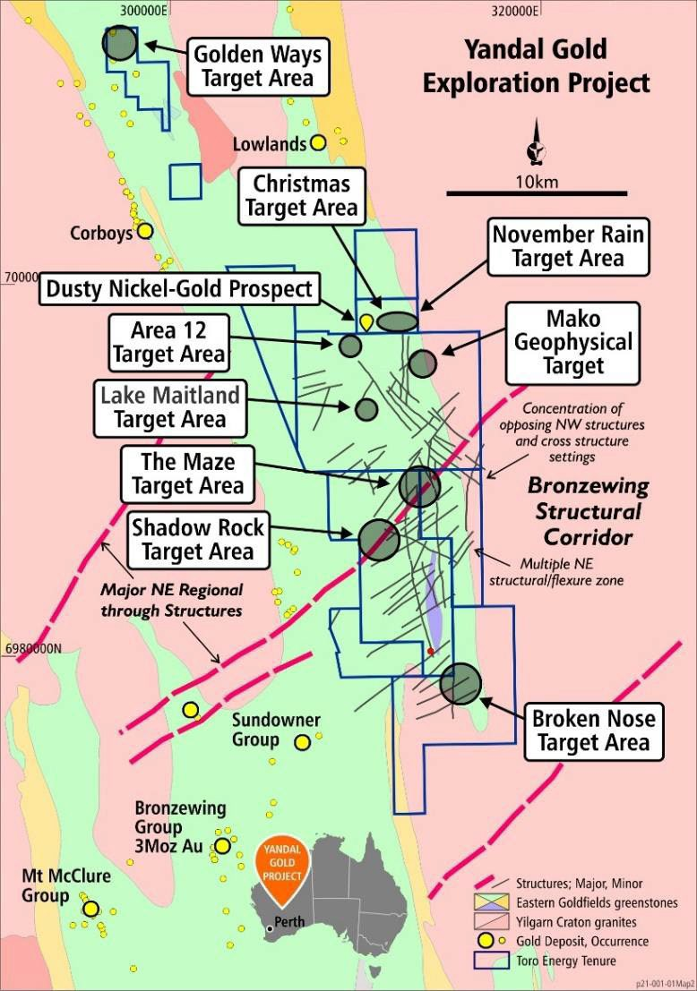
YANDAL GOLD AND BASE METAL PROJECT
The Yandal Gold and Base Metal Project is located only 20km NE of the world class Bronzewing Gold Mine and the Mt McClure, Bronzewing and Sundowner group gold deposits.
It is a unique exploration opportunity - comprising some 243 square kilometres of the mature world class gold district, the Yandal Greenstone Belt - yet it remains relatively untested due to most of the ground being held by uranium companies since the discovery of the Lake Maitland Uranium Deposit in 1972 – a greenfields exploration project in the middle of a proven mature gold district.
In the main Project area, the rocks are hidden beneath a thick transported cover, making exploration difficult but further ensuring the basement geology has remained under- explored.
A detailed airborne magnetic survey combined with an extensive ground gravity survey and passive seismic survey
have highlighted well over 70 target zones based on structural relationships with physical properties alone.
First pass aircore drilling with limited reverse circulation drilling and geochemical signatures in diamond core has confirmed prospective greenstone geology for gold and base metal exploration.
At least 10 separate target areas so far defined despite only very limited coverage of the project to date.

Slide 24
DUSTY NICKEL: 2022 EXPLORATION
Diamond drilling program continues to 2022 year end - target more nickel sulphides at Dusty testing along strike as well as up and down dip of existing intersects.
Next phase drilling may concentrate on exploration through the paleochannel cover outside the existing discovery zones, with the aim of:
  Continuing to test the Dusty Komatiite for more massive nickel sulphide discoveries.
  Testing for further favourable geology for nickel sulphides within the project area.
  Follow-up exploration within the Lake Maitland Central Target Area where two previous drill holes have uncovered favourable geology and geochemistry for gold and/or base metal mineralisation.
A reverse circulation (RC) drill rig may be brought in to:
  Continue gold exploration in the Golden Ways Target Area, particularly regarding deeper tests of the outcropping veins previously drilled at shallow depths in 2020 and new drilling around the historical New England Prospect.
  Open up more previously untested ground within the Yandal Gold Project for gold prospectivity.
  Aid nickel exploration where cover material is favourable for RC drilling.

Slide 25
URANIUM OPPORTUNITIES and ECONOMIC UPSIDE
Opportunities identified to improve the Lake Maitland Uranium Project include:
U₃O₈ values in drilling results derived from geochemistry are often higher than what can be explained by positive disequilibrium and are often above the 1.25 disequilibrium factor already applied across the Lake Maitland deposit to gamma probe derived U₃O₈ values.
Therefore further core based drilling with geochemistry and upgrading of the U₃O₈ resource from Indicated to Measured will result in an increase to the overall U₃O₈ resource and ultimately more U₃O₈ produced by any mining and processing operation.
Due to the inherent relationship between uranium and vanadium in the potassium uranium vanadate ore mineral, carnotite, it is likely that with further drilling the V₂O₅ resource will be upgraded to Indicated status (JORC 2012) and therefore increase the value of the resource and the Lake Maitland Uranium Project.
Further refinement of the Lake Maitland Uranium Project flowsheet to reduce costs may be possible after a large scale pilot of the beneficiation circuit.
JAURD and Itochu have the right to Joint Venture at Lake Maitland.

Slide 26
URANIUM OPPORTUNITIES (Ctd)
The proposed production schedule does not include any Mineral Resources from Toro’s three other 100% owned uranium deposits comprising the Wiluna Project namely, Centipede, Millipede and Lake Way.
This could lead to increased mine life, increased production and increased revenue adding considerable value to the Lake Maitland Uranium Project. Integrating the other uranium deposits under the broader Wiluna Uranium Project may add value to the project in terms of extending the project and de-risking the dependency on Lake Maitland as a stand-alone operation.
Investigate opportunity to process high grade well beyond the 7th year of production.
Further beneficiation test work at Toro’s three other 100% owned uranium deposits comprising the Wiluna Uranium Project, Centipede, Millipede and Lake Way, could show that parts of those deposit may be amenable to the same significant cost efficiencies as established in the Scoping Study for Lake Maitland.
Updating of the Scoping Study components to ensure interfaces between each Study component are well aligned may highlight potential opportunities/synergies for the Lake Maitland Uranium Project, particularly in relation to foreseen interfaces between pit dewatering, mining, hydrology, waste rock storage, tailings storage, hydrology, hydrogeology and mine closure.

Slide 27
NEAR-TERM CATALYSTS
Continue to advance optimisation opportunities across the whole Wiluna Uranium Project
Significant optionality to maximise financial and technical feasibility
Pre-feasibility Study will include large scale pilot of the beneficiation circuit
Drilling programs at Dusty Nickel Project and Yandal Gold Project
First assay results from 2022 Dusty program expected Q4 2022
Yandal Gold Project results pending
28.2Mlbs of U₃O₈ outside Wiluna Uranium Project – exploration campaign to upgrade Mineral Resources
Total Inventory of 90.9Mlbs of U₃O₈ and 68Mlbs of V₂O₅

Slide 28
APPENDIX 1 - REFERENCES
Echo Resources Limited ASX release 22 August 2017.
Phillips, G. N, and Anand, R. R. (2000) Importance of the Yandal greenstone belt, In Yandal Greenstone Belt Regolith, Geology and Mineralisation, (eds) Phillips, G. N, and Anand, R. R., CRC for Landscape Evolution and Mineral Exploration, AIG Bulletin No. 32, July 2000.
Echo Resources Limited Mineral Resource and Ore Reserve Estimates, refer to ASX Release 27 November 2017.
For further information on the beneficiation and processing improvements on the Wiluna Uranium Project please refer to ASX announcements of 18 May, 29 August and 28 September 2016; 20 April, 20 June, 27
June, 12 September and 19 September 2018; and 7 March and 18 March 2019.
For further information on the Yandal Gold Project, including the airborne magnetic survey, ground gravity survey and all drilling releases and their accompanying JORC Table 1, please refer to ASX announcements of 23 May, 3 May, 23 May, 29 June, 26 September, 17 October, 6 November and 9 November 2018; and 21
March, 9 April, 28 May, 11 June, 26 June, 9 July and 25 July 2019.
For further information on the 2016 drilling at the Yandal One nickel prospect please refer to ASX announcements of 11 December 2015 and 25 November 2016.

Slide 29
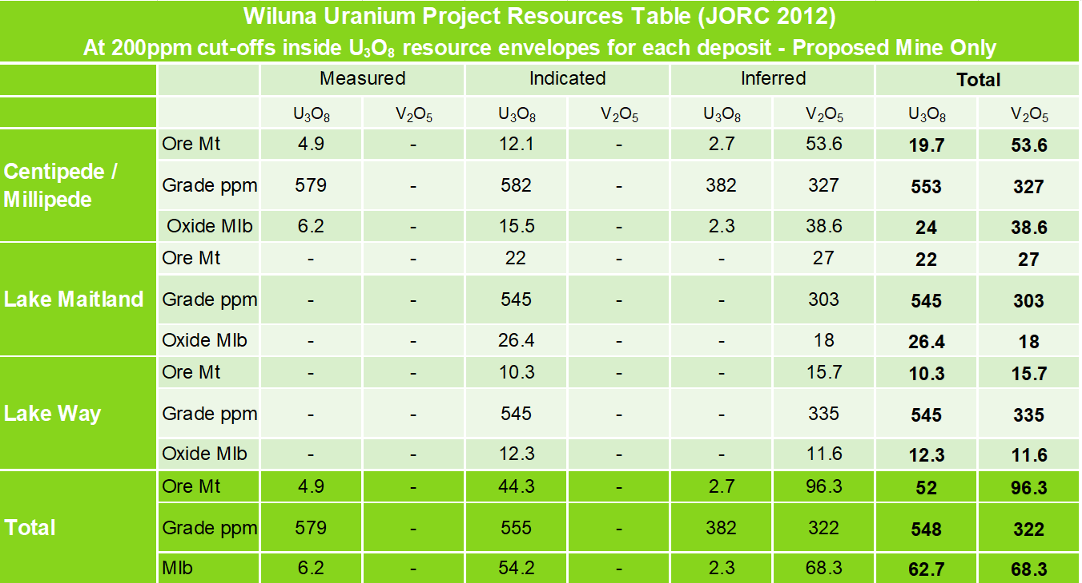
APPENDIX 2 - RESOURCES

Slide 30
APPENDIX 3 : COMPETENT PERSONS STATEMENTS
Competent Persons Statement – Geology and Exploration
The information in this document that relates to geology and exploration was authorised by Dr Greg Shirtliff, who is a full- time employee of Toro Energy Limited. Dr Shirtliff is a Member of the Australian Institute of Mining and Metallurgy and has sufficient experience of relevance to the tasks with which he was employed to qualify as a Competent Person as defined in the 2012 Edition of the Joint Ore Reserves Committee (JORC) Australasian Code for Reporting of Exploration Results, Mineral Resources and Ore Reserves. Dr Shirtliff consents to the inclusion in the report of matters based on information in the form and context in which it appears.
Competent Persons’ Statement
Wiluna Project Mineral Resources – 2012 JORC Code Compliant Resource Estimates – U₃O₈ and V₂O₅ for Centipede-Millipede, Lake Way and Lake Maitland.
The information presented here that relates to U₃O₈ and V₂O₅ Mineral Resources of the Centipede-Millipede, Lake Way and Lake Maitland deposits is based on information compiled by Dr Greg Shirtliff of Toro Energy Limited and Mr Daniel Guibal of Condor Geostats Services Pty Ltd. Mr Guibal takes overall responsibility for the Resource Estimate, and Dr Shirtliff takes responsibility for the integrity of the data supplied for the estimation. Dr Shirtliff is a Member of the Australasian Institute of Mining and Metallurgy (AusIMM) and Mr Guibal is a Fellow of the AusIMM and they have sufficient experience which is relevant to the style of mineralisation and type of deposit under consideration and to the activity they are undertaking to qualify as Competent Persons as defined in the 2012 Edition of the ‘Australasian Code for Reporting of Exploration Results, Mineral Resources and Ore Reserves (JORC Code 2012)’. The Competent Persons consent to the inclusion in this release of the matters based on the information in the form and context in which it appears.
.

Slide 31
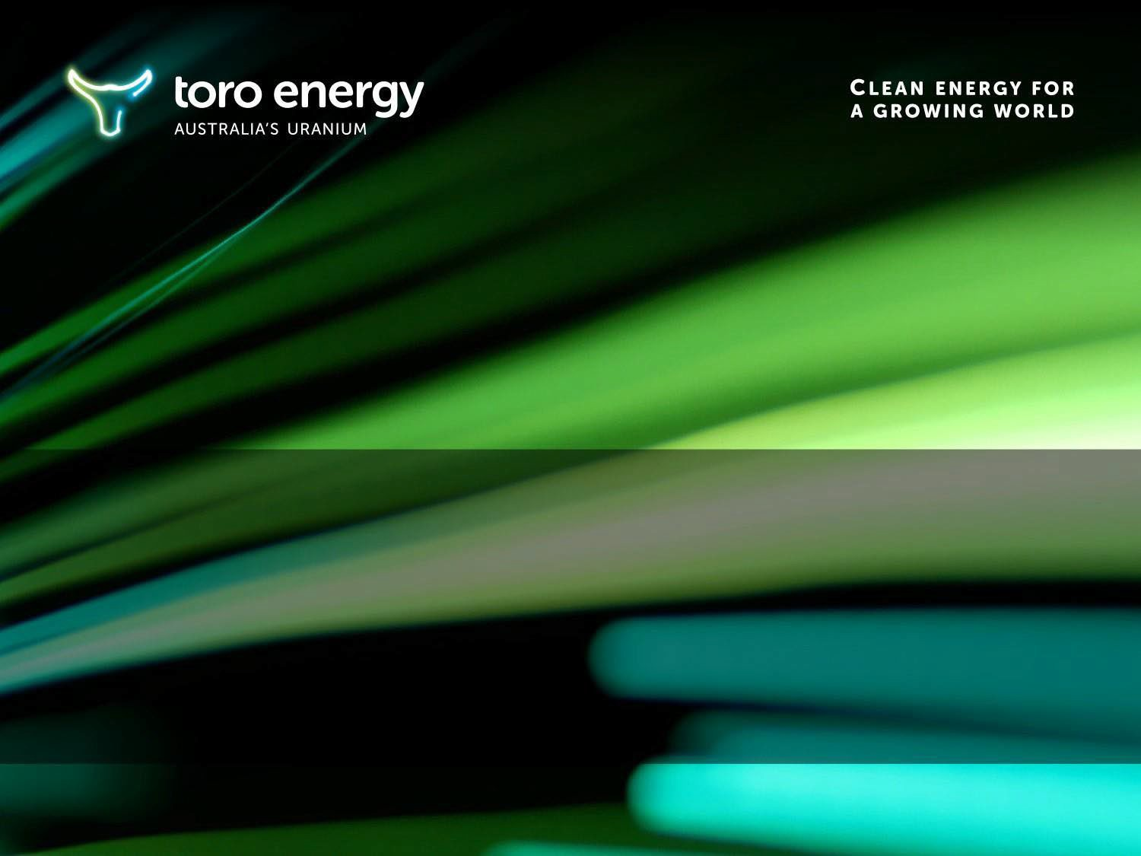

toroenergy.com.au
60 Havelock Street,
WEST PERTH 6005
Western Australia Telephone: +61 8 9214 2100

